Slide 1






SHRI VAISHNAV VIDHYAPEETH VISHWAVIDHYALAYA
SHREE VAISHNAV INSTITUTE OF INFORMATION TECHNOLOGY
Department of Computer Science and Engineering
ANCHOR TAG
Submitted To :- Submitted By :-
Mr Sachin Chirgaiya Sir Atharv Sonwaniya

Slide 2

The HTML Anchor Tag: Unlocking Web Navigation

Slide 3

What is the Anchor (<a>) Tag?
Defines a Hyperlink
The <a> tag creates a hyperlink, establishing connections between different web pages or sections within a single document.
Web's Foundation
It means the basic system that makes the internet work is links connecting pages together & helping you move around web and information.

Slide 4
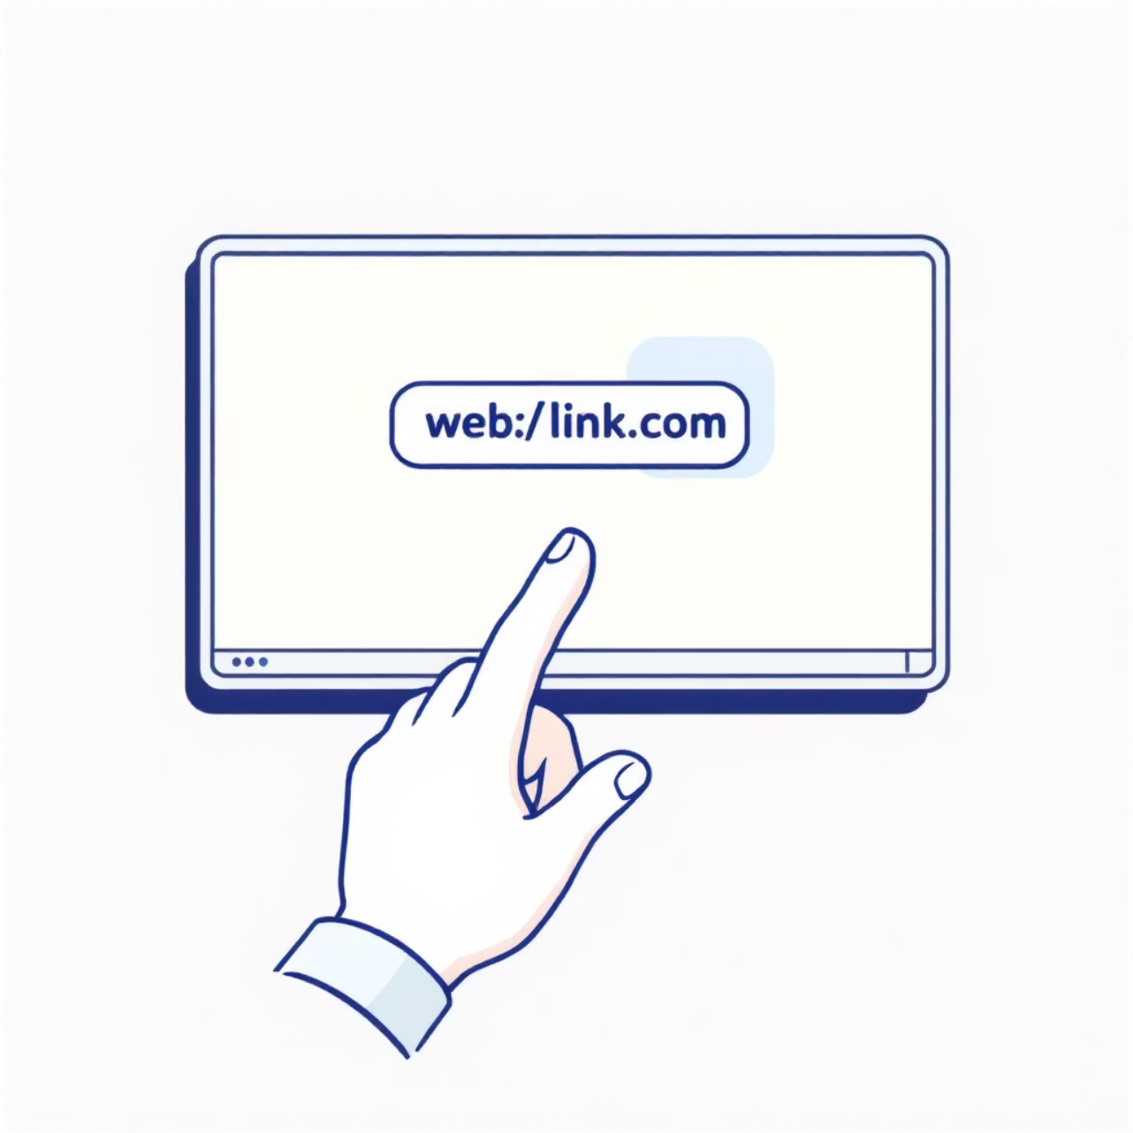




The Most Important Attribute: href
The href attribute tells a link where to go.
It contains the URL of the link.
It can opens websites, pages, emails, or phone numbers.
Without href, a link will not work.
Example: <a href="https://www.w3schools.com">Visit W3Schools</a>

Slide 5










Beyond URLs: Special href Values
mailto:
tel:
javascript:
Opens the email app to send an email. Example: <a href="mailto:info@example.com">Email Us</a>
Starts a phone call on mobile devices Example: <a href="tel:+123456789">Call Us</a>
Runs a small program when the link is clicked.
Example: Used for actions instead of opening a page.

Slide 6

Opening Links: The target Attribute
_self (Default)
Opens the linked document in the same tab or window where the user is currently browsing.
_blank
Opens the linked document in a new browser tab or window, keeping the original page open.
_parent & _top
These targets are used in specific scenarios involving frames, referring to the parent frame set or the full browser window, respectively.
Example: <a href="https://example.com" target="_blank">Open in new tab</a>

Slide 7





Downloading Files with Anchor Tags
The download attribute transforms a regular link into a file download prompt. Instead of navigating to the linked resource, the browser will prompt the user to save the file.
Example: <a href="/files/report.pdf" download>Download Report</a>
This feature is particularly useful for offering documents, images, or other media files for offline access. It mainly work for files from the same website, for safety resons.

Slide 8
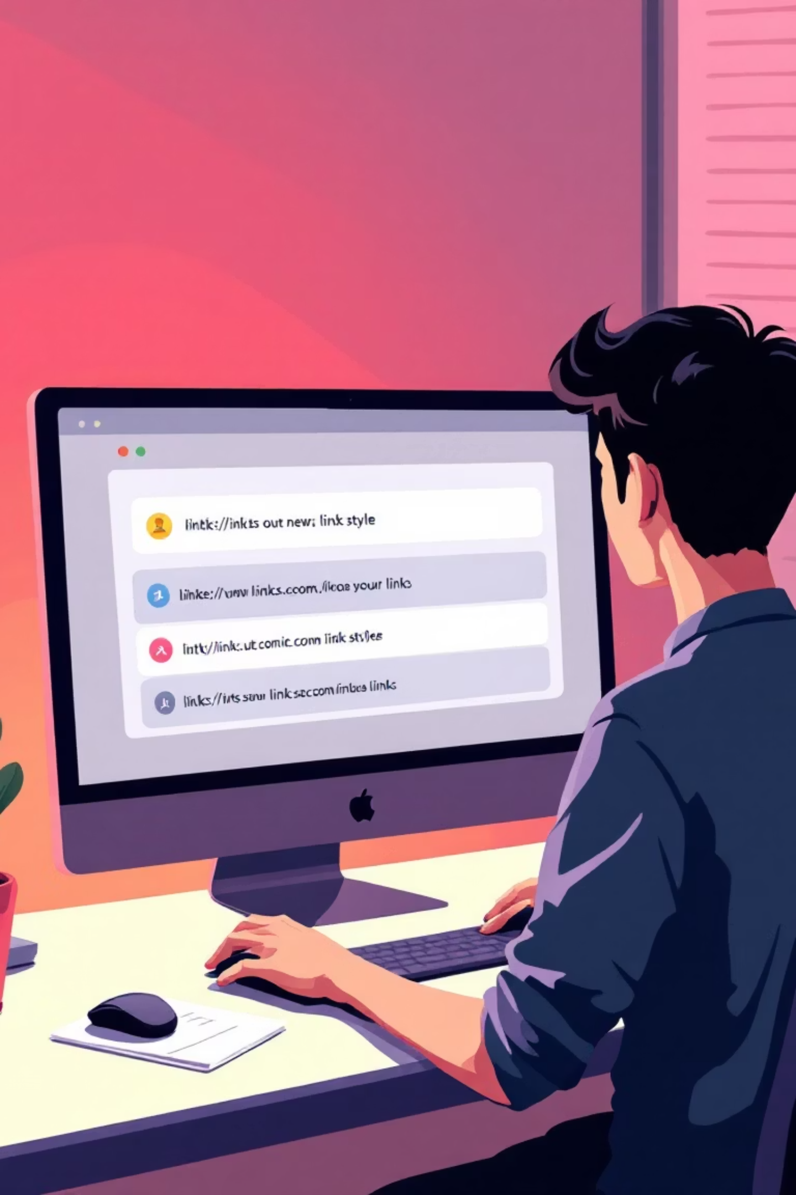

Styling & Accessibility Tips
Default Link Styles
Links typically appear blue and underlined (unvisited), purple (visited), and red (active).
Custom Styling
Utilize CSS to customize link appearance, including colors, font styles, and hover effects, to match your website's design.
Title Attribute for Tooltips
Add a title attribute to provide helpful tooltips on hover, enhancing user experience. Example: <a href="#" title="More info">Link</a>
Meaningful Link Text
Ensure link text is descriptive and meaningful for screen readers, improving accessibility for all users.

Slide 9


Common Pitfalls & Troubleshooting
01
02
Missing href
Non-Unique IDs
An anchor tag without an href attribute acts as a placeholder and won't function as a clickable link.
IDs must be unique within a page. Duplicate IDs can lead to unpredictable navigation or script errors.
03
04
JavaScript/CSS Interference
Cross-Browser Testing
Be mindful that JavaScript or custom CSS can sometimes override or interfere with the default behavior of anchor tags.
Always test your links across different browsers and devices to ensure consistent functionality and user experience.

Slide 10










Summary: The Power of the Anchor Tag
Versatile Linking
Mastering its attributes enables links to pages, sections, emails, and downloads.
Web's Backbone
The <a> tag is essential for web navigation and interactivity.
User-Friendly Design
Good design makes websites easy to use & understand for everyone.

Slide 11
